Slide 1
Mel-Frequency Cepstral Coefficients Explained Easily

Slide 2
Mel-Frequency Cepstral Coefficients

Slide 3
Mel-Frequency Cepstral Coefficients

Slide 4
Mel-Frequency Cepstral Coefficients

Slide 5
Mel-Frequency Cepstral Coefficients

Slide 6
Cepstrum Spectrum

Slide 7
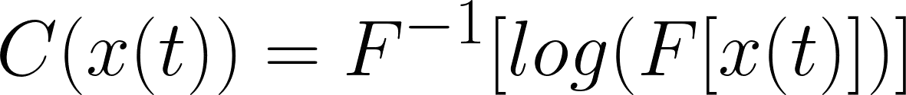
Computing the cepstrum

Slide 8
Computing the cepstrum
Time-domain signal

Slide 9
Computing the cepstrum
Time-domain signal
Spectrum

Slide 10
Computing the cepstrum
Time-domain signal
Spectrum
Log spectrum

Slide 11
Computing the cepstrum
Time-domain signal
Log spectrum
Spectrum
Cepstrum

Slide 12
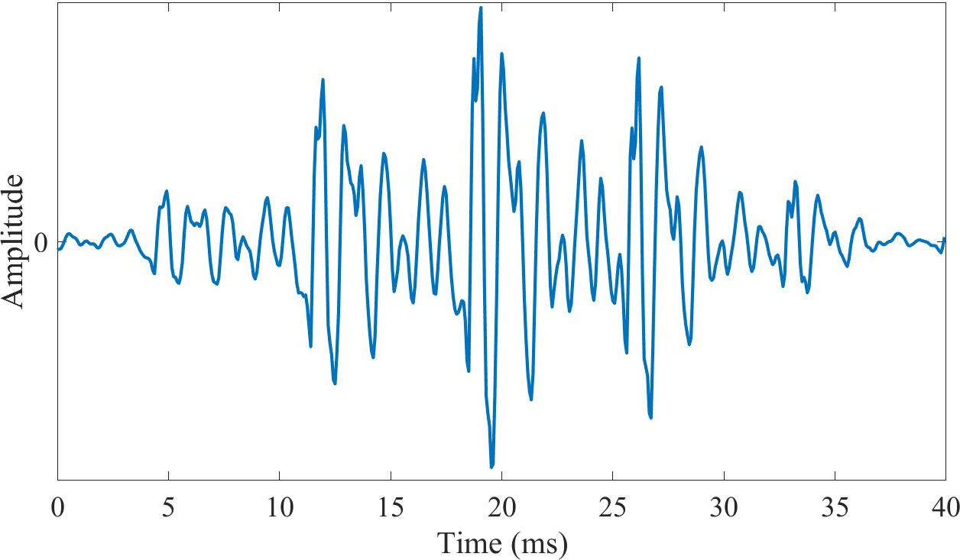
Visualising the cepstrum
Signal

Slide 13
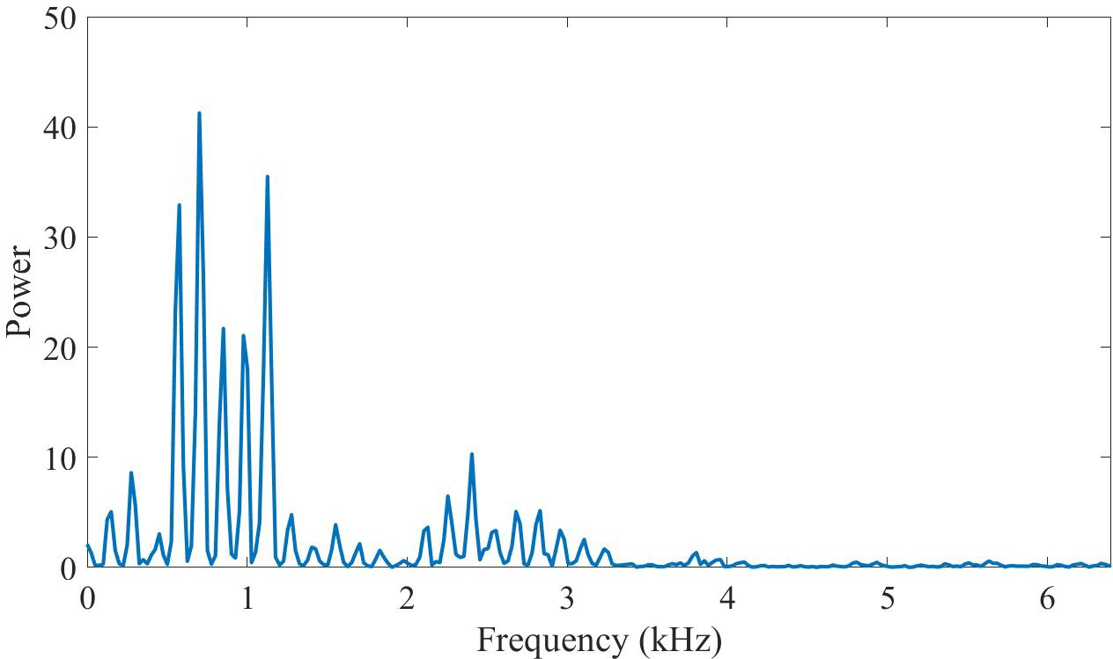
Visualising the cepstrum
Signal
Power spectrum
DFT

Slide 14
Visualising the cepstrum
Power spectrum

Slide 15
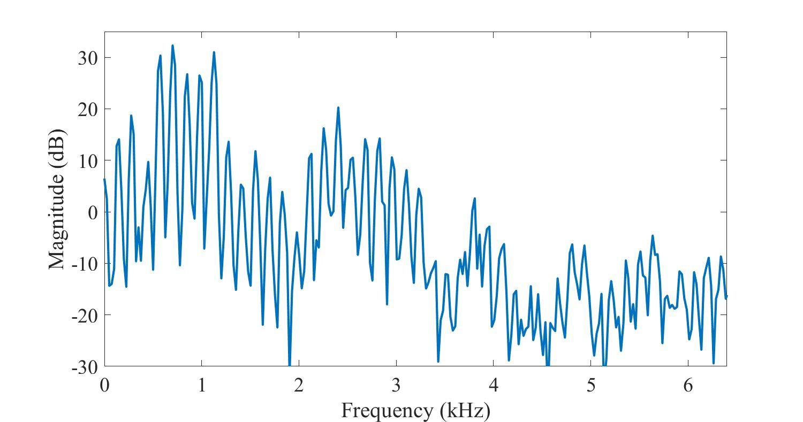
Visualising the cepstrum
Power spectrum
Log power spectrum
log

Slide 16
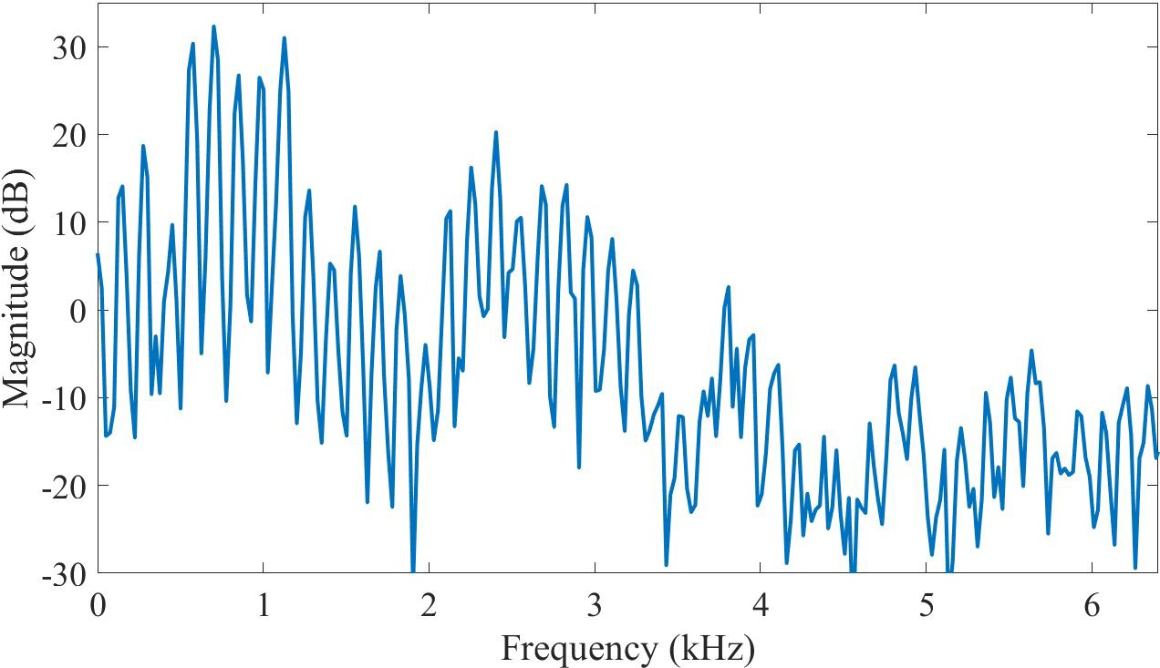
Visualising the cepstrum
Log power spectrum

Slide 17
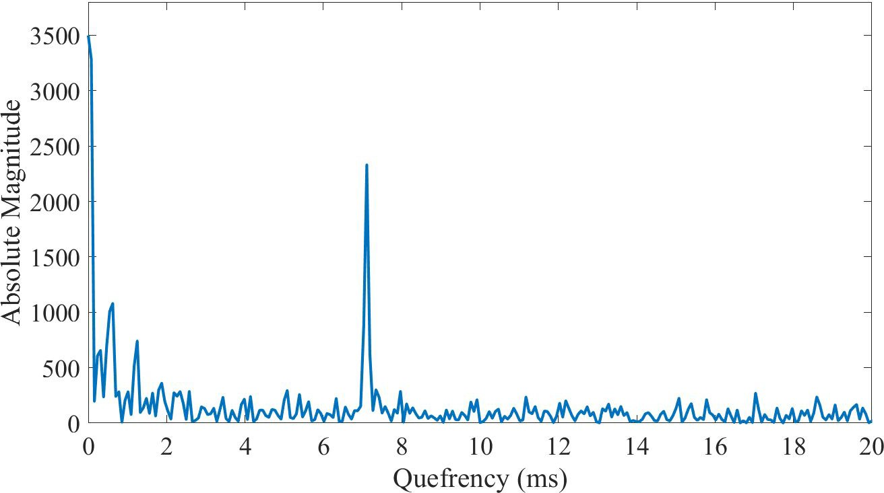
Visualising the cepstrum
Log power spectrum
Cepstrum
IDFT

Slide 18
Visualising the cepstrum
Log power spectrum
Cepstrum
IDFT
????

Slide 19
Visualising the cepstrum
Log power spectrum
Cepstrum
IDFT

Slide 20
Visualising the cepstrum
Log power spectrum
Cepstrum
IDFT
1st rhamonic

Slide 21
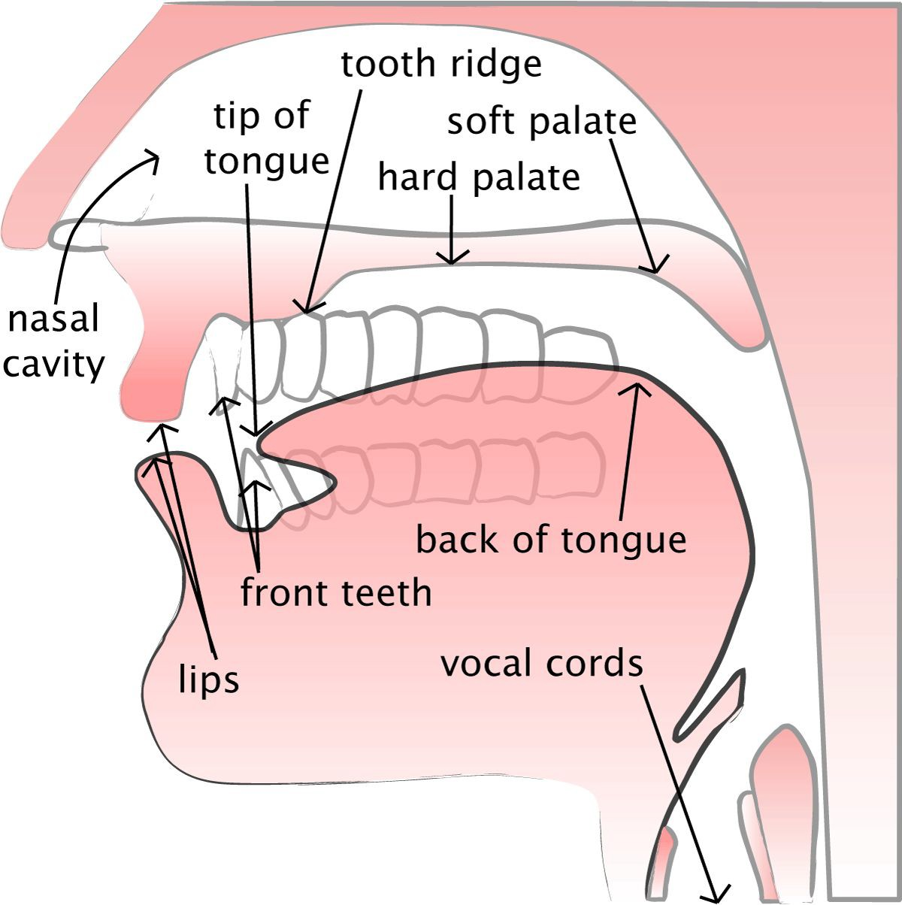
The vocal tract

Slide 22
The vocal tract
Vocal tract acts as a filter

Slide 23
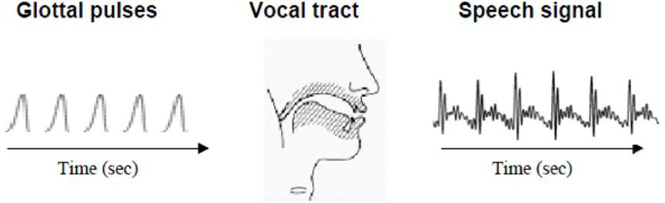
Speech generation

Slide 24
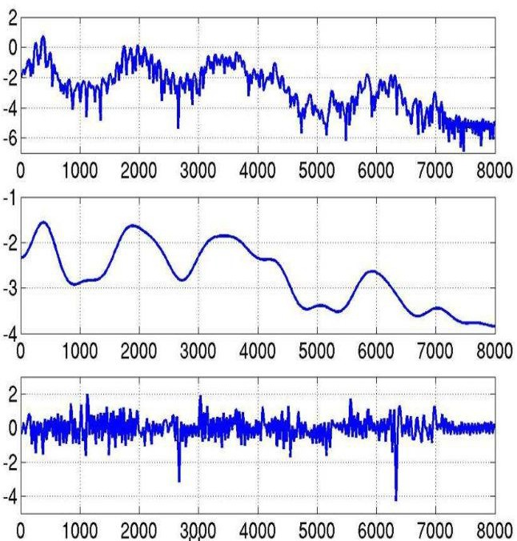
Understanding the cepstrum
Log-spectrum
dB
Speech
Hz

Slide 25
Understanding the cepstrum
Log-spectrum
dB
Speech
Spectral envelope
Hz

Slide 26
Understanding the cepstrum
Log-spectrum
dB
Speech
Spectral envelope
Hz

Slide 27
Understanding the cepstrum
Log-spectrum
dB
Speech
Spectral envelope
Hz
Formants = Carry identity of sound

Slide 28
Understanding the cepstrum
Log-spectrum
dB
Speech
Spectral envelope
Vocal tract frequency response
Hz

Slide 29
Understanding the cepstrum
Log-spectrum
dB
Speech
Spectral envelope
Vocal tract frequency response
Hz

Slide 30
Understanding the cepstrum
Log-spectrum
dB
Speech
Spectral envelope
Vocal tract frequency response
Spectral detail
Hz

Slide 31
Understanding the cepstrum
Log-spectrum
dB
Speech
Spectral envelope
Vocal tract frequency response
Spectral detail
Glottal pulse
Hz

Slide 32
Speech
=
Convolution of vocal tract frequency response with
glottal pulse

Slide 33
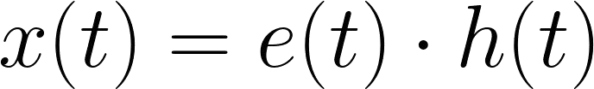
Formalising speech

Slide 34
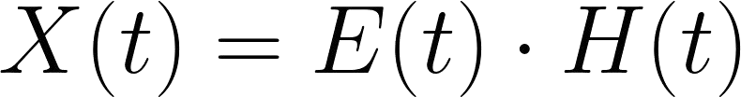
Formalising speech

Slide 35
Formalising speech

Slide 36
Formalising speech

Slide 37
Formalising speech

Slide 38
Formalising speech

Slide 39
Formalising speech
Speech
Vocal tract frequency response
d B
Glottal pulse
Hz

Slide 40
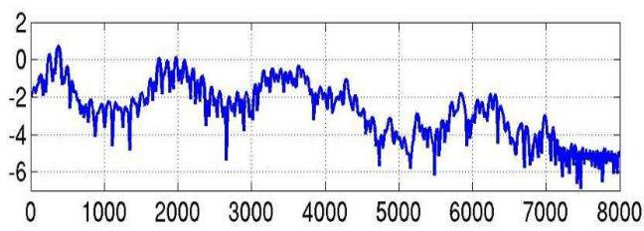
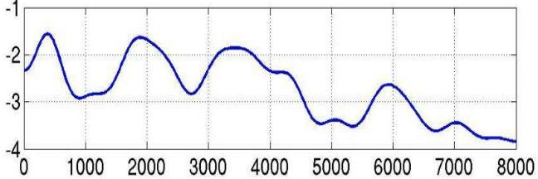
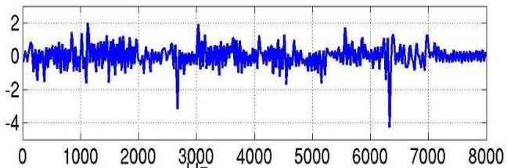
The goal: Separating components

Slide 41
The goal: Separating components

Slide 42
Separating components
d B
Hz

Slide 43
Separating components
IDFT
quefrency
d B
Hz

Slide 44
Separating components
4 Hz
IDFT
quefrency
d B
Hz

Slide 45
Separating components
100 Hz
IDFT
quefrency
d B
Hz

Slide 46
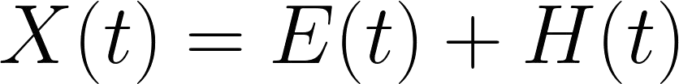
Separating components
IDFT
quefrency
d B
Hz

Slide 47
Separating components
IDFT
quefrency
d B
Hz

Slide 48
Computing Mel-Frequency Cepstral Coefficients
Waveform

Slide 49
Computing Mel-Frequency Cepstral Coefficients
Waveform
DFT

Slide 50
Computing Mel-Frequency Cepstral Coefficients
Waveform
DFT
Log-Amplitude Spectrum

Slide 51
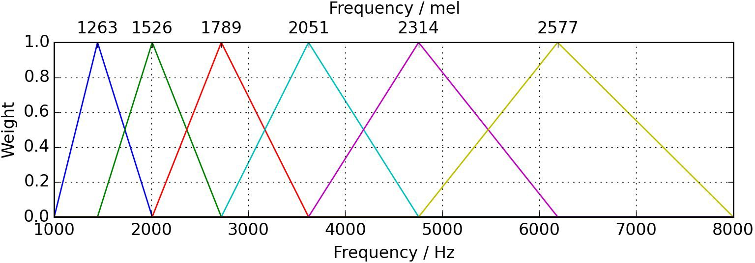
Computing Mel-Frequency Cepstral Coefficients
Waveform
DFT
Log-Amplitude Spectrum
Mel-Scaling

Slide 52
Computing Mel-Frequency Cepstral Coefficients
Waveform
DFT
Log-Amplitude Spectrum
Mel-Scaling
Discrete Cosine Transform
MFCCs

Slide 53
Why Discrete Cosine Transform?
Simplified version of Fourier Transform

Slide 54
Why Discrete Cosine Transform?
Simplified version of Fourier Transform
Get real-valued coefficient

Slide 55
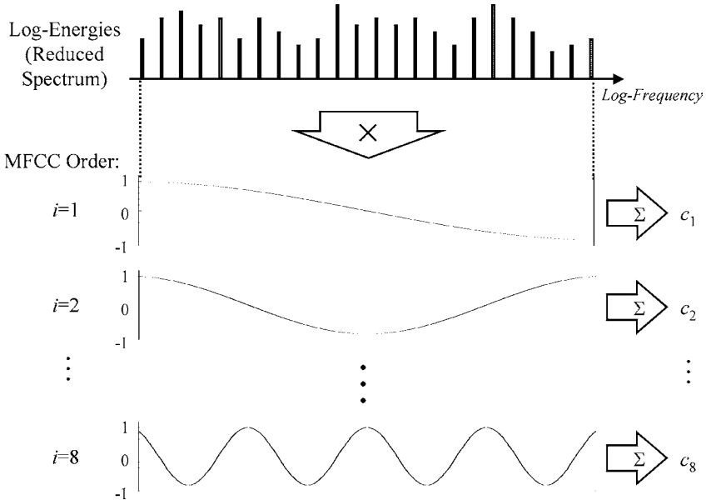
Why Discrete Cosine Transform?
Simplified version of Fourier Transform
Get real-valued coefficient

Slide 56
Why Discrete Cosine Transform?
Simplified version of Fourier Transform
Get real-valued coefficient
Decorrelate energy in different mel bands

Slide 57
Why Discrete Cosine Transform?
Simplified version of Fourier Transform
Get real-valued coefficient
Decorrelate energy in different mel bands
Reduce # dimensions to represent spectrum

Slide 58
How many coefficients?
Traditionally: first 12 - 13 coefficients
First coefficients keep most information (e.g., formants, spectral envelope)
Use Δ and ΔΔ MFCCs
Total 39 coefficients per frame

Slide 59
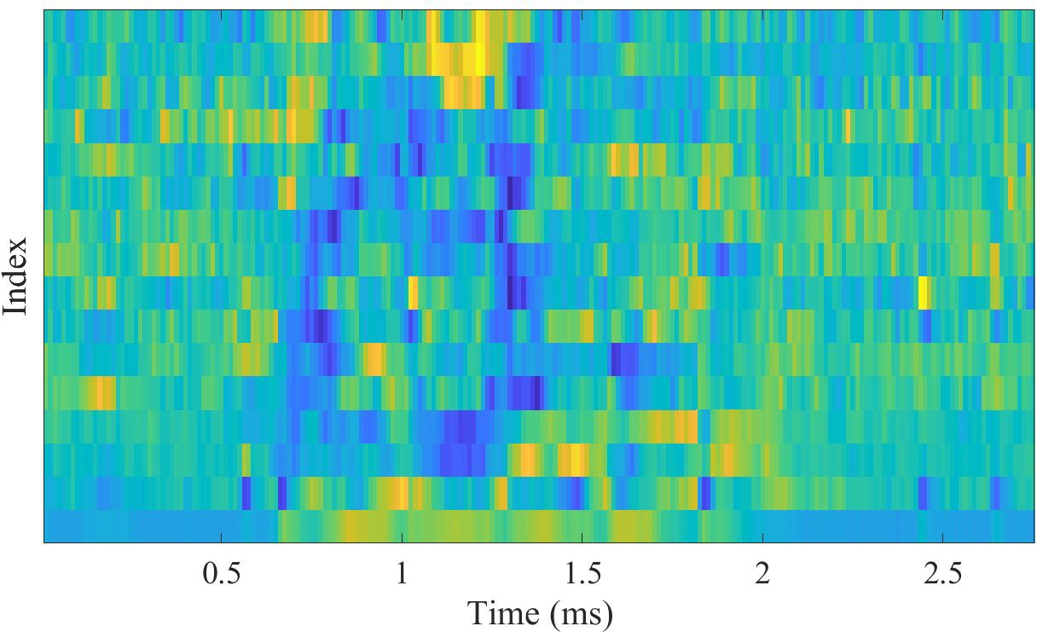
Visualising MFCCs

Slide 60
Visualising MFCCs
# frames
# coefficients

Slide 61
MFCCs advantages
Describe the “large” structures of the spectrum
Ignore fine spectral structures
Work well in speech and music processing

Slide 62
MFCCs disadvantages
Not robust to noise
Extensive knowledge engineering
Not efficient for synthesis

Slide 63
MFCCs applications
Speech processing
Speech recognition
Speaker recognition
...
Music processing
Music genre classification
Mood classification
Automatic tagging
...

